Slide 1

Introduction to Deep Learning
Feb 2019

Slide 2
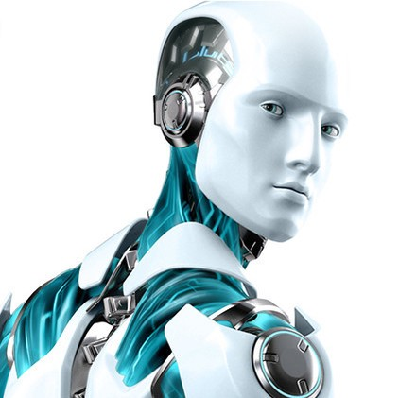

Artificial Intelligence
Artificial intelligence is the intelligence exhibited by computers, rather than humans.
| 02

Slide 3
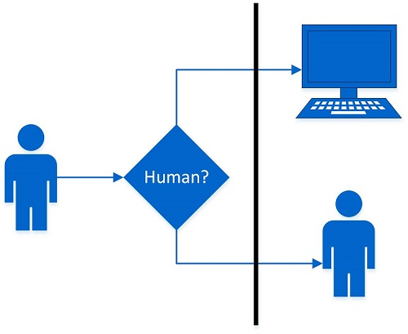
Turing Test - The Earliest Idea of AI
In an conversation between both a human and a machine, the machine tries convinces the human evaluator that he/she indeed is talking to a human
The conversation is limited to text.
The evaluator knows one of the agents is a computer
If the evaluator cannot reliably tell the machine from a human, the machine is said to have passed the test
| 02

Slide 4
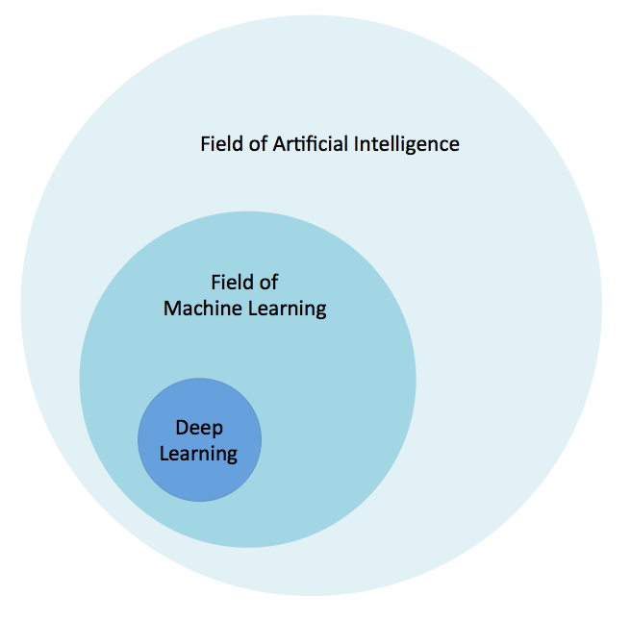
The AI Canvas
Artificial Intelligence is the intelligence exhibited by computers.
Machine Learning is one way of doing that, by using algorithms to get insights from data.
Deep Learning is one way of doing that, using a specific algorithm called a Neural Network
| 02

Slide 5
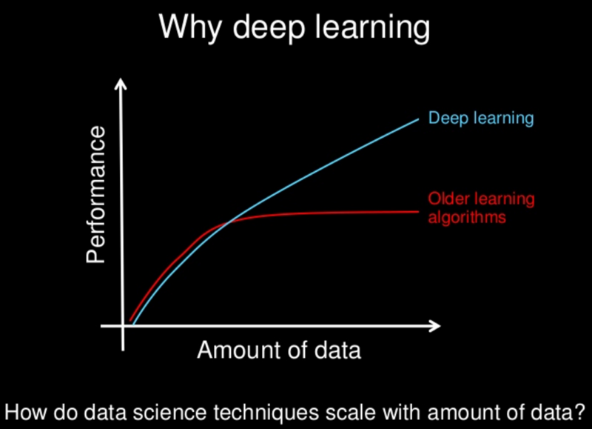
Why Deep Learning?
| 02

Slide 6
Applications of Deep Learning
Computer Vision
Natural Language Processing
Speech Processing
Reinforcement Learning
| 03

Slide 7
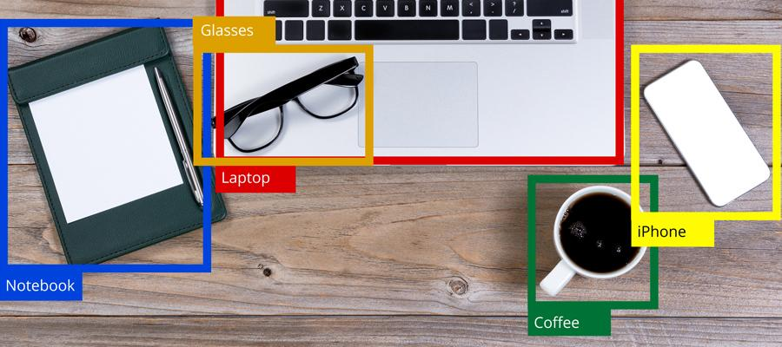
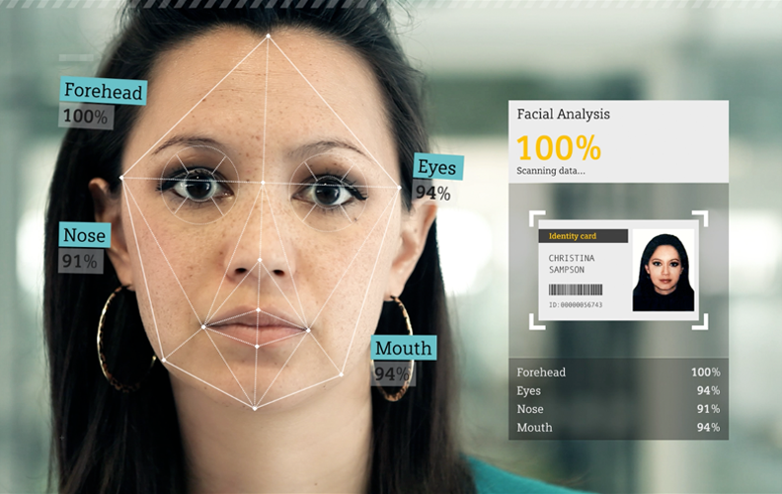
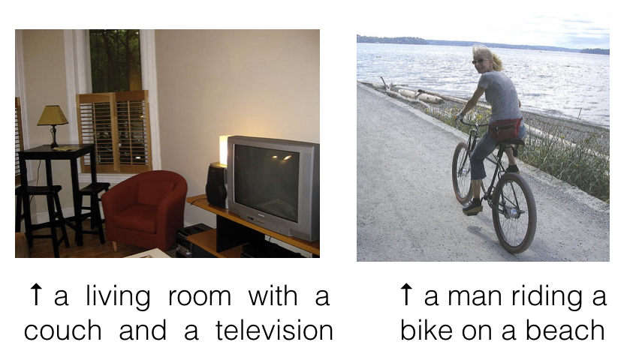
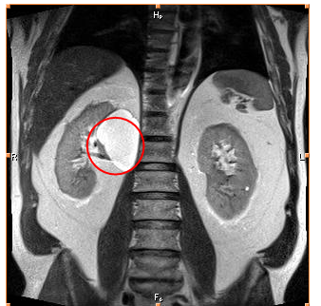
Applications in Computer Vision
Object recognition
Facial recognition
Tumour Detection
Image Captioning
| 03

Slide 8
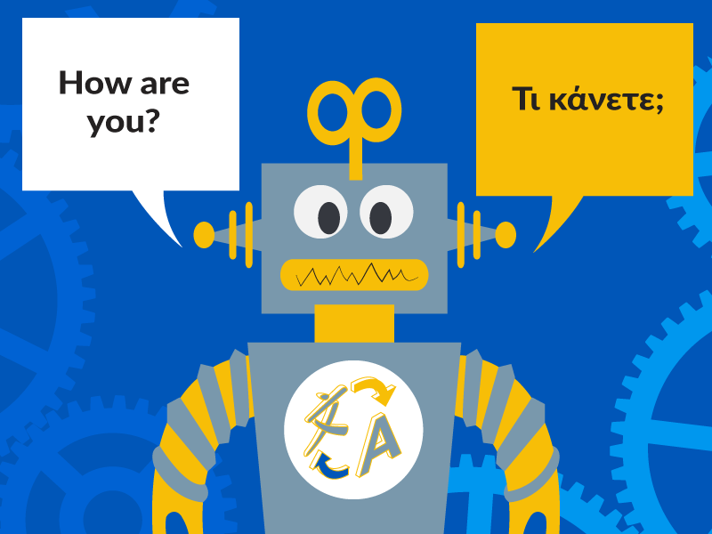
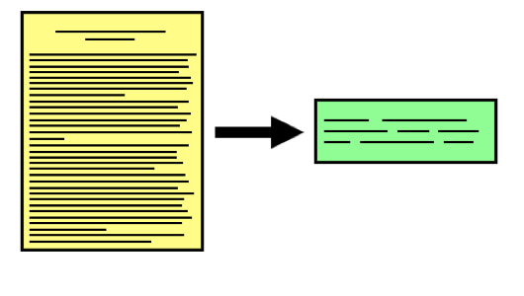
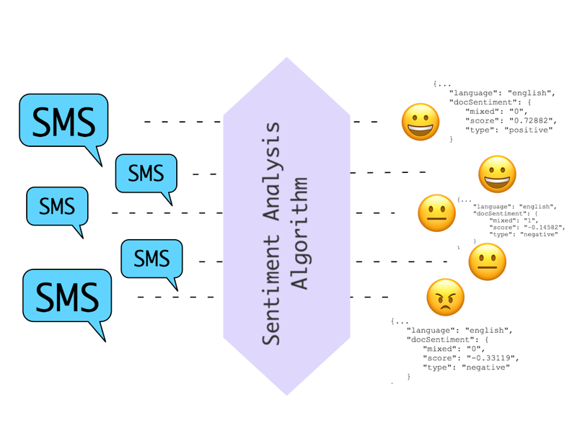

Applications in Natural Language Processing
Machine Translation
Text Summarization
Q/A Chatbots
Sentiment Analysis
| 03

Slide 9
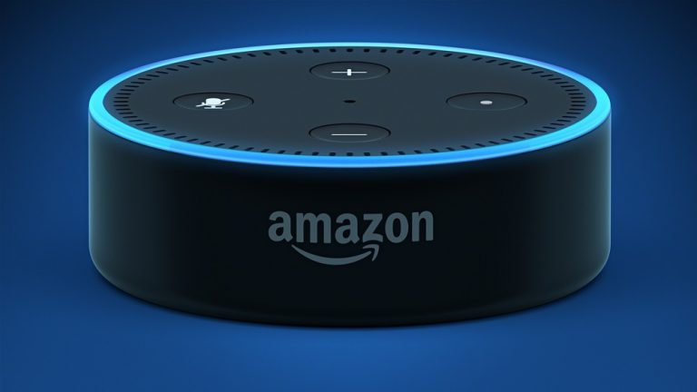

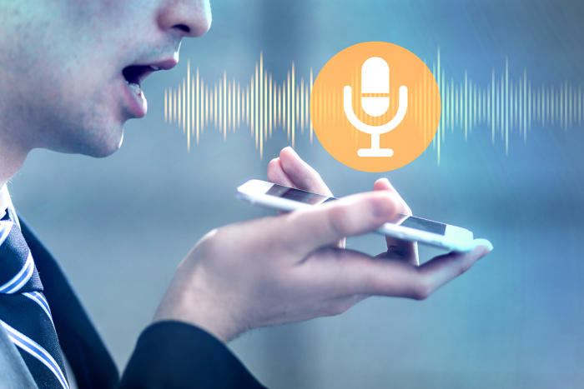
Applications in Speech Recognition
Conversational Agents
Speech to Text
Voice Recognition
| 03

Slide 10


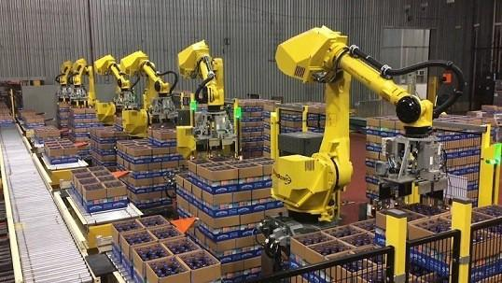
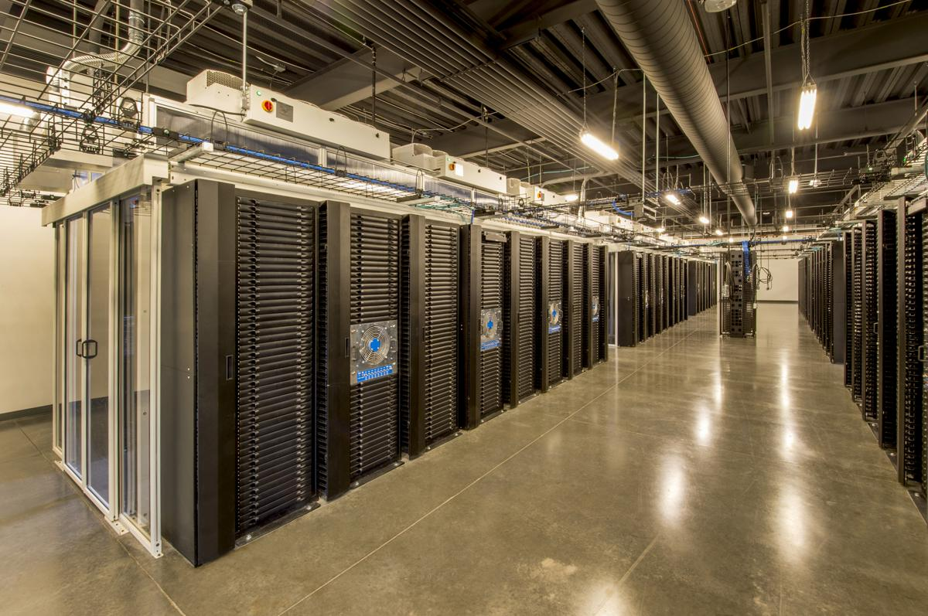
Applications in Reinforcement Learning
Personalised Recommendation
AlphaGo
Inventory Management
Power Management
| 03

Slide 11





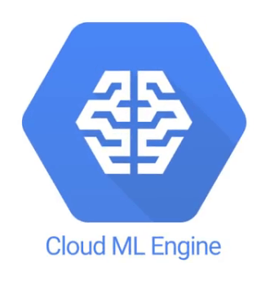


Cloud Providers in AI Space
Training/Deploying on Cloud
| 02

Slide 12



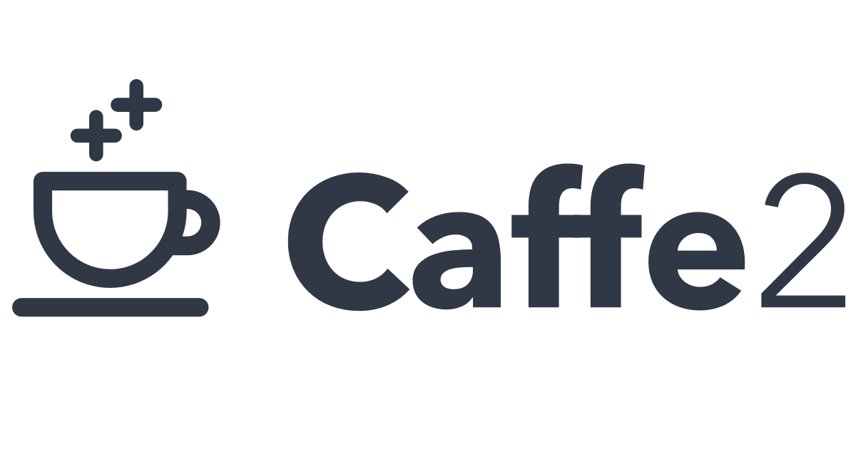



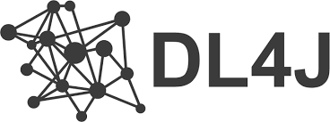

Popular Deep Learning Frameworks
| 03

Slide 13
Terminology
Sample
It is set of data entries
Features
The number of distinct traits that can be used to describe each item in a quantitative manner
Feature Vector
It is an n-dimensional vector of features that represents a data entry
Model
It is something that is trained with data using an algorithm and does prediction
Training set & testing set
Dataset that is used to train a model is called training set
Dataset that is used to test a model is called testing set
| 02

Slide 14
Types of Learning
Supervised Learning
The data that is fed includes the desirable solutions called labels.
Example: Classification, Regression
Unsupervised Learning
The data that is fed is unlabelled.
Example: Clustering
Reinforcement Learning
The system can observe the environment, select and perform action and get rewards or penalties in return, thereby determining optimal strategy.
| 02

Slide 15
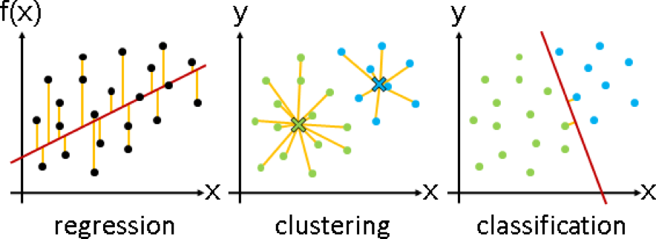
Classification - Regression - Clustering
| 02

Slide 16
Spam Filter Example
Sender
Receiver
Title
Content
Attachments
Spam
Not Spam
Mail
Features
Labels
Traditional Rule Based Approach - Drawbacks (Scalability, Reliance, Revision, Laborious)
How does Artificially intelligent systems solve the problems?
| 02

Slide 17
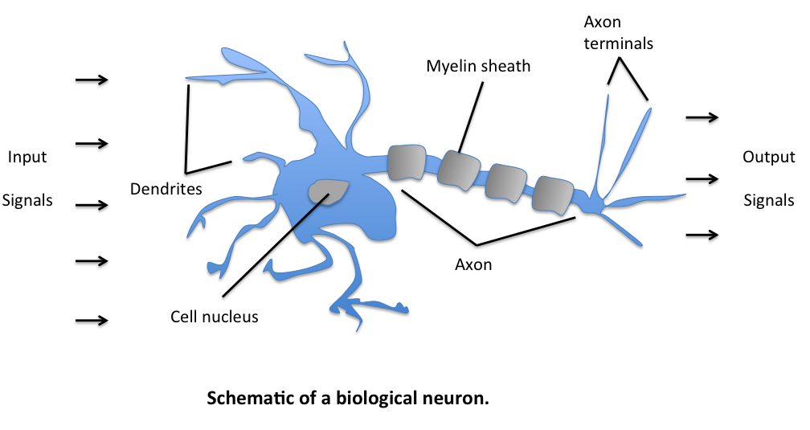
Enter Deep Learning: Bio-inspired Artificial Neurons
| 03

Slide 18
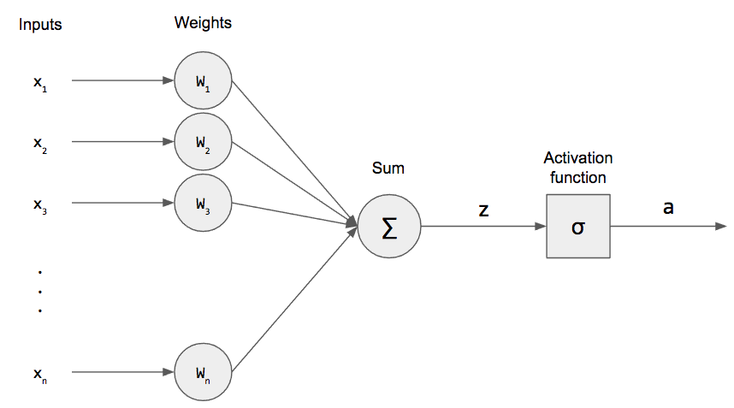
What’s going on inside? - The idea of Perceptron
| 03

Slide 19
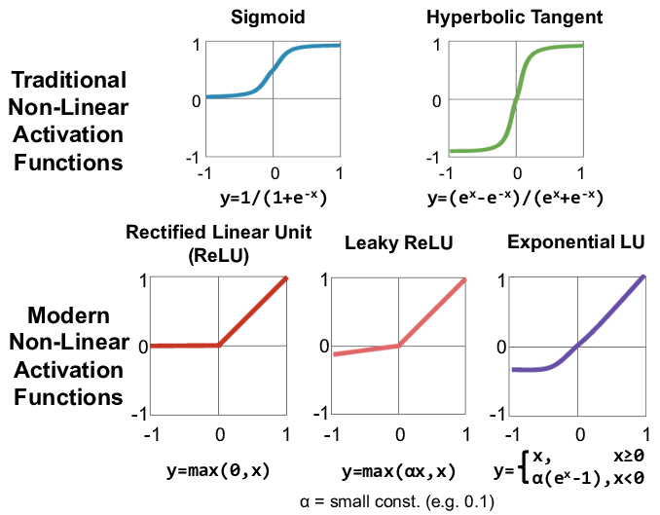
Activation Functions
| 03

Slide 20
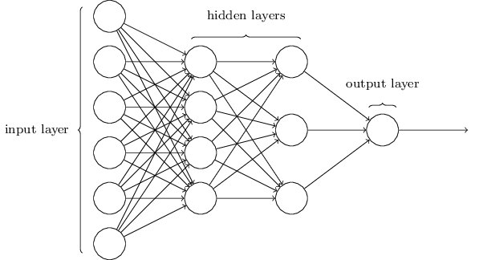
Neural Networks
| 03

Slide 21
Example: House Price Prediction
Features: area, bedrooms, zip code
Label: price
Area - x1
bedrooms - x2
y - Price
Zip code - x3
Input
Hidden Units
Output
| 03

Slide 22
How Deep Learning Is Done - Procedure
01
Data Acquisition
Data residing in various sources is gathered and aggregated
02
Data Cleansing
Corrupted and sparse data is removed
03
Data Preparation
Necessary formatting of data is done that model can consume
04
Model Training
Train the model with the data collected
05
Testing
Evaluate the performance of the model using various metrics
06
Deployment
Deploy the model into production environment once the performance is good enough
| 03

Slide 23
Setup
Download Python
Upgrade Pip
pip3 install --upgrade pip
Isolated environment with virtualenv
pip3 install --user --upgrade virtualenv
cd /ML_PATH
virtualenv env
source env/bin/activate
Install packages
pip3 install --upgrade jupyter matplotlib numpy tensorflow keras
Wifi - Wavelabs-Guest, password: Think_Before_You_Start
Add Github link
| 02

Slide 24
Our First Neural Network
| 02

Slide 25
Tunable Parameters
Optimization Strategies
Gradient Descent
Momentum optimization
Nesterov Accelerated Gradient
AdaGrad
RMSProp
Adam
Learning Rate Scheduling
Performance Scheduling
Exponential Scheduling
Power Scheduling
Regularization Strategies
Early Stopping
Dropout
Data Augmentation
l1 and l2 regularization
| 02

Slide 26
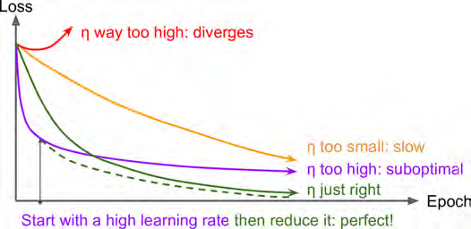
Tuning Optimal Learning Rate
| 02

Slide 27
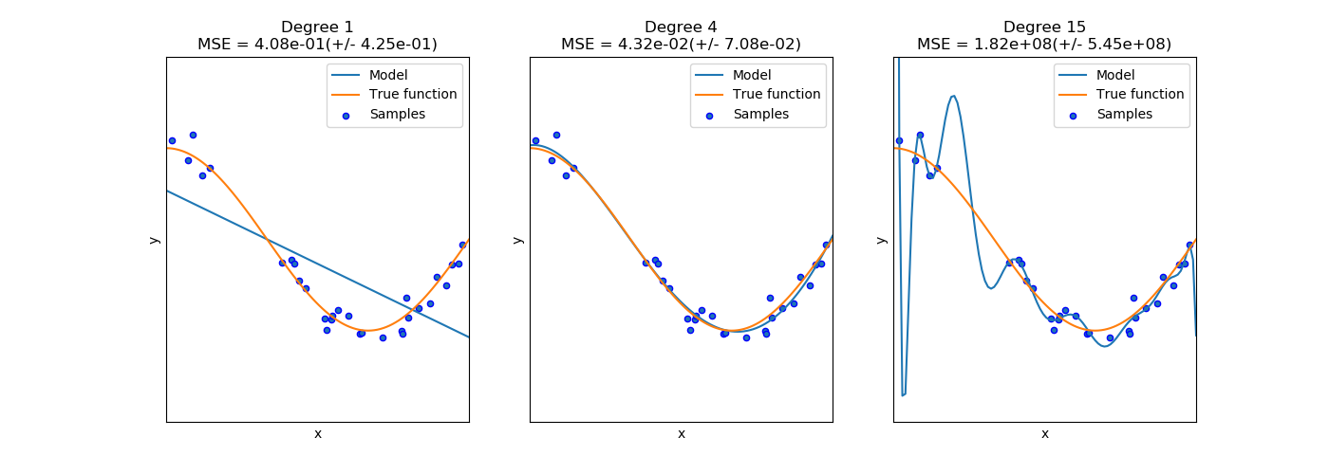
The Overfitting Problem
The first graph depicts, the model (blue) can’t under-fits the data (orange)
The second graphs depicts a good fit, where the model generalises well
The third graph depicts overfit where the accuracy is very high (~100%)
The model tries to fit every data point including the outliers
Hence fails to predict more general scenarios, resulting in very low test accuracy.
| 02

Slide 28
Next Steps
Convolutional Neural Networks (Computer Vision)
Object detection
Facial Recognition
Image Segmentation
Neural Style Transfer
Recurrent Neural Networks
Gated Recurrent Units
Long Short Term Memory Units
Bi-directional RNNs
Autoencoders
Basic
Deionising
Variational
Generative Adversarial Networks
Deep Reinforcement Learning
| 02

Slide 29
Thank You

